Slide 1


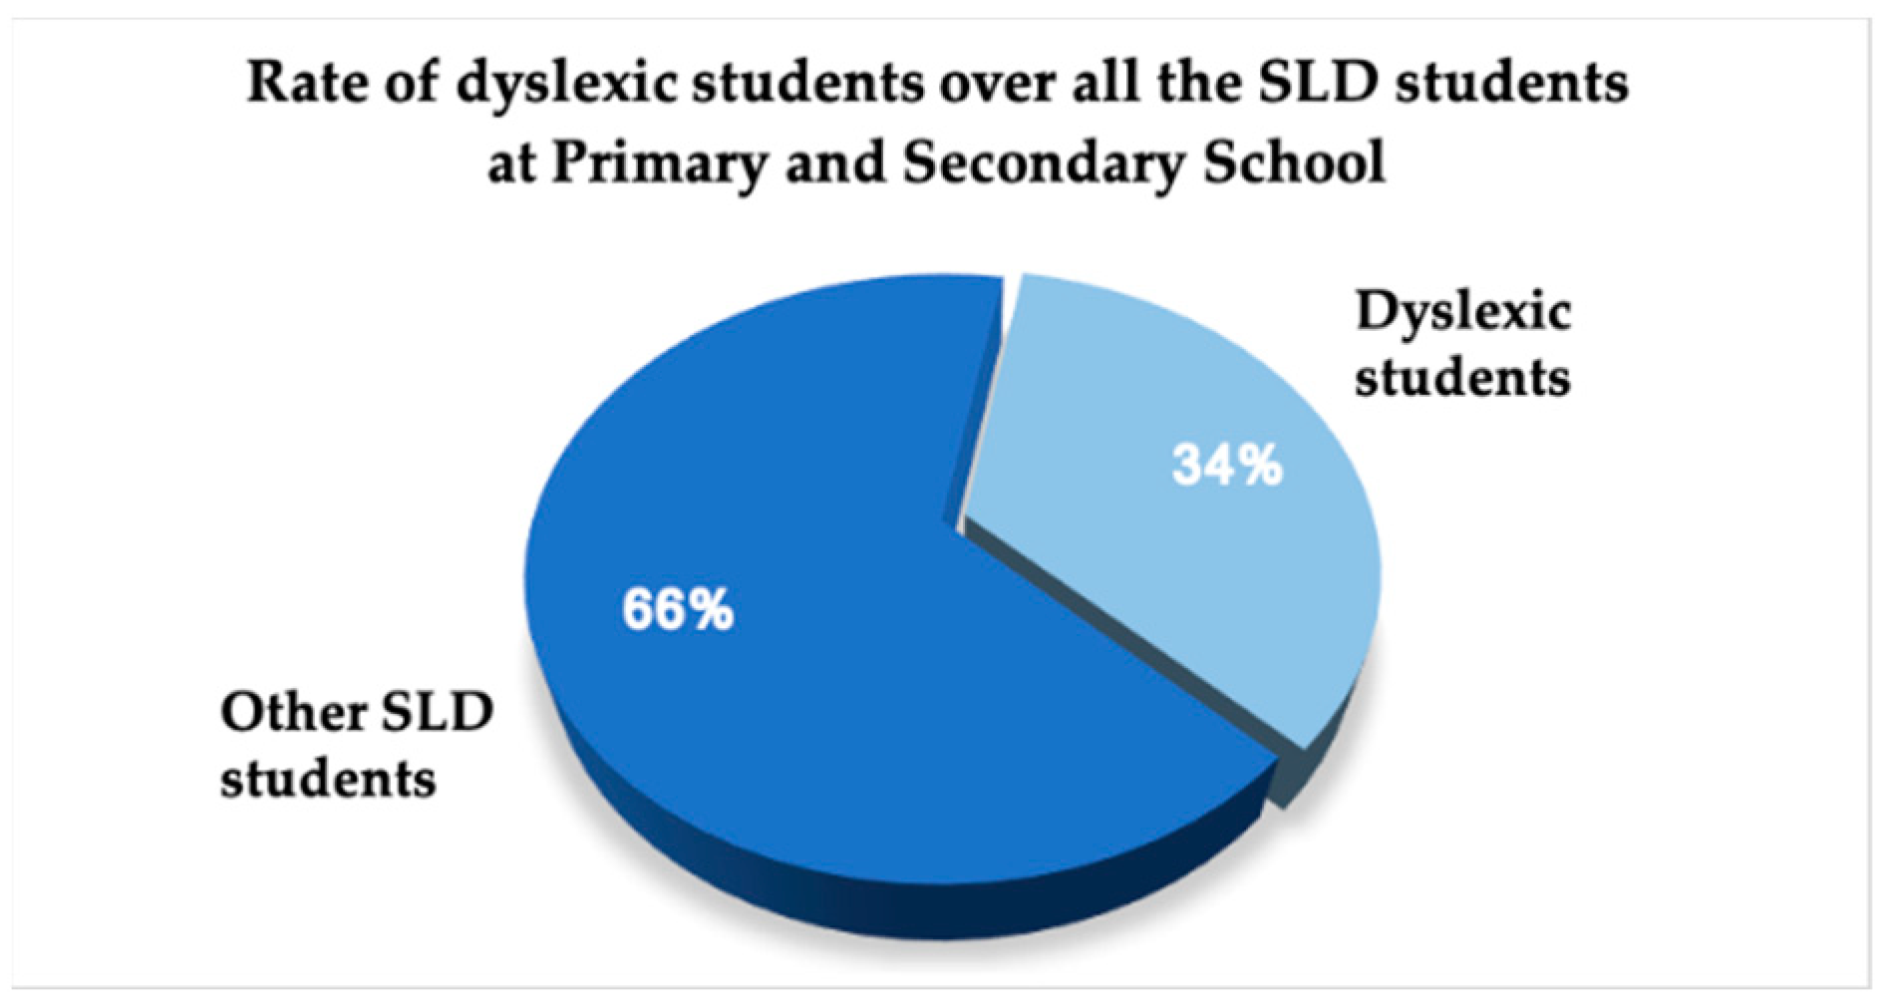
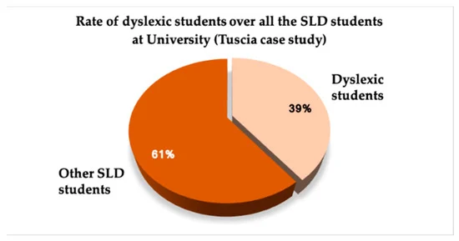
Introduction to Dyslexia
Dyslexia is a learning disorder that affects a child's ability to read, write, and spell. It's important to understand the challenges these children face and how to support them effectively.
Between 5% and 20% of Indians suffer from dyslexia, with urban regions having a higher prevalence of the condition. This indicates that millions of Indian schoolchildren experience reading and comprehension problems as a result of this disorder.
.a

Slide 2
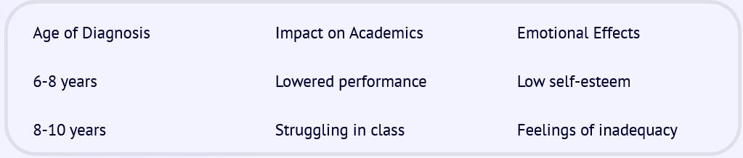
Prevalence and Impact of Dyslexia in India
Challenges Faced
Educational Impact
Societal Implications
Dyslexia is often undiagnosed in India, leading to academic and emotional difficulties.
The prevalence of dyslexia affects children's learning outcomes and self-esteem.
Dyslexic children may face discrimination and limited opportunities.

Slide 3



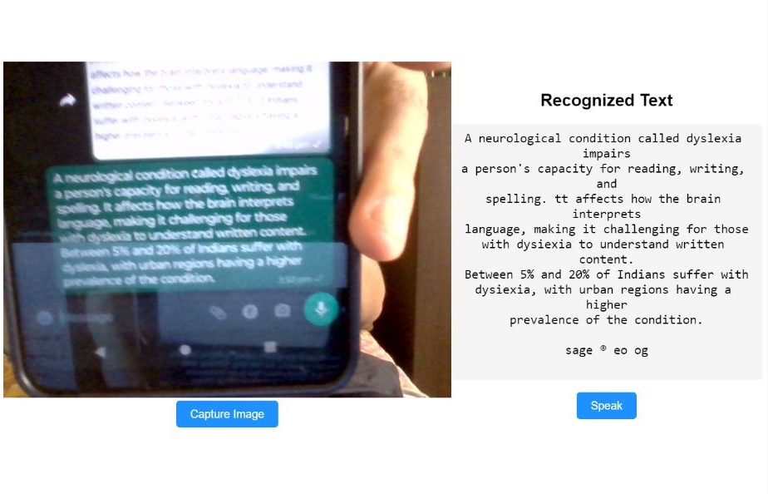
Introduction to Dyslexify Web Application
The creation of solutions like our product Dyslexify, a machine learning initiative intended to help people with Dyslexia improve their reading and comprehension skills.
Image-to-speech recognition
Text-to-speech recognition
Javascript Extension
Ml-driven suggestion of books, using daal4py
Ai-powered document assistant, using GPU strength
3d model with AR interface
Dyslexify has the potential to significantly improve the lives of students in India and around the world and will have a major impact on the education sector.
Though there's no cure for dyslexia, early assessment and intervention result in the best outcome. Sometimes dyslexia goes undiagnosed for years and isn't recognized until adulthood, but it's never too late to seek help.

Slide 4
Technology Used
Implementation
Machine Learning and AI: Dyslexify uses machine learning and AI technologies such as to develop its features, such as image-to-speech recognition, text-to-speech recognition, and personalized reading experience.
Framework: Flask, React
Programming Languages: Python, Javascript
APIs and Integrations: OpenAI, GPT 3.5 3D
Dyslexify's low-scale implementation may cost Rs. 10,000 for development and a few thousand to a few tens of thousands of Indian Rupees per month for operation.
For a large-scale implementation, the development cost can range from Rs. 1 lakhs to 5 lakhs, and the operating cost can be several lakhs of Indian Rupees per month, depending on various factors.

Slide 5



TEAM MEMBERS
VIVEK KUMAR
(CYBER SECURITY)
SARTHAK JOSHI
(ML/AI)
ABHISHEK SINGH MAURYA
(WEB DEVELOPER)

Slide 6
THANK YOU

